Slide 1
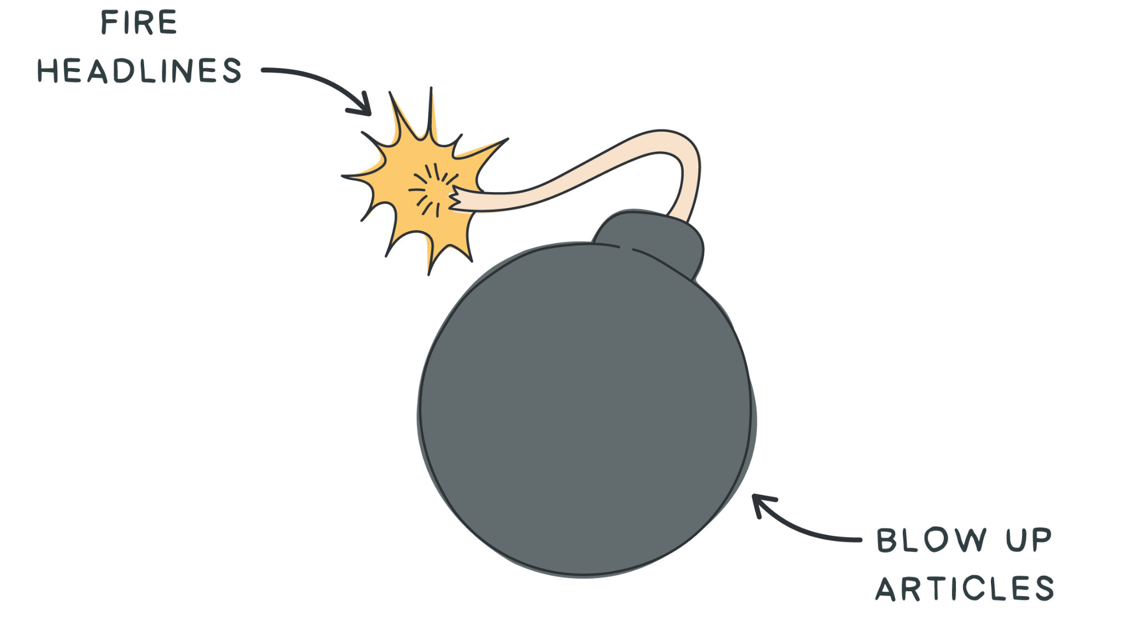
SESSION 4
Write
Amazing
Headlines
By Shaan Puri
POWER WRITING COURSE

Slide 2
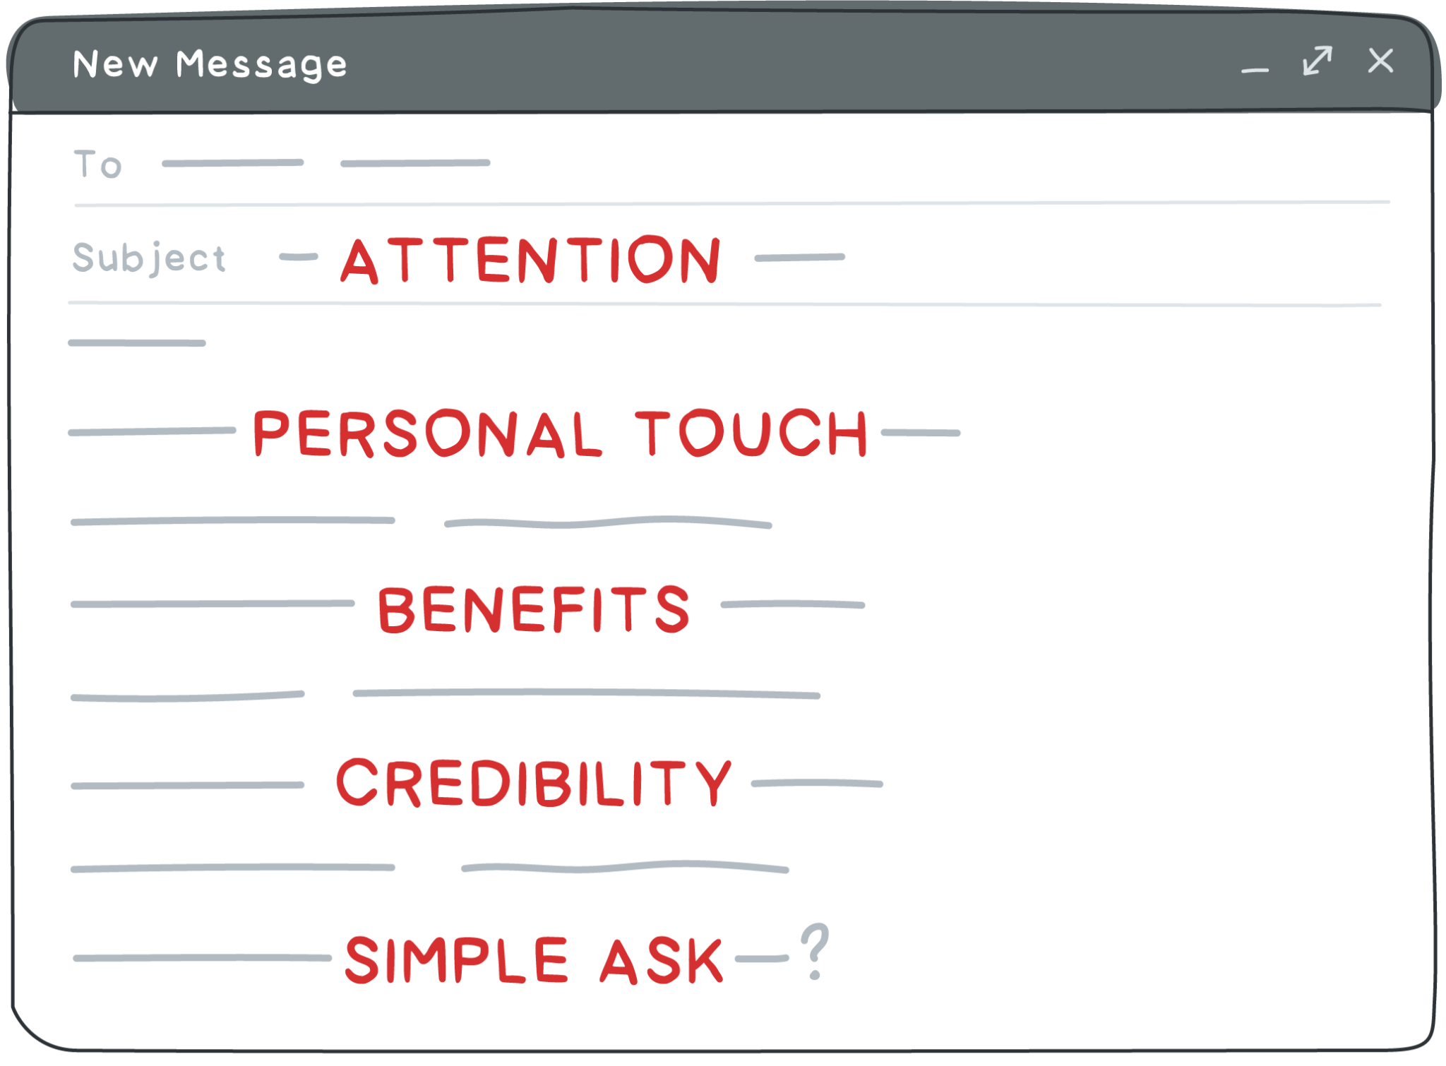
Session #1 - CCCCCCOLD EMAILS

Slide 3
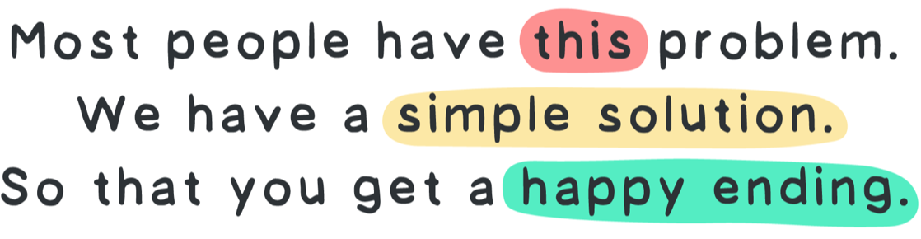
Habits
Copywork
Swipe file
Walk away edit
&

Slide 4
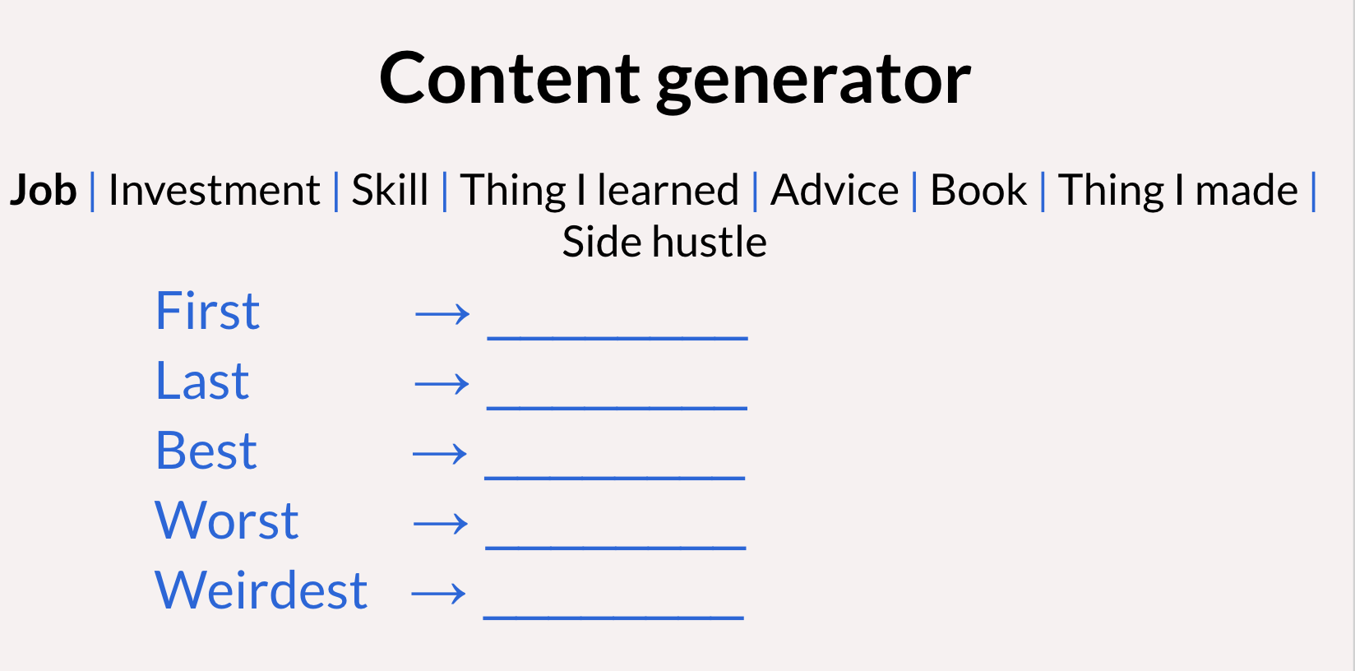
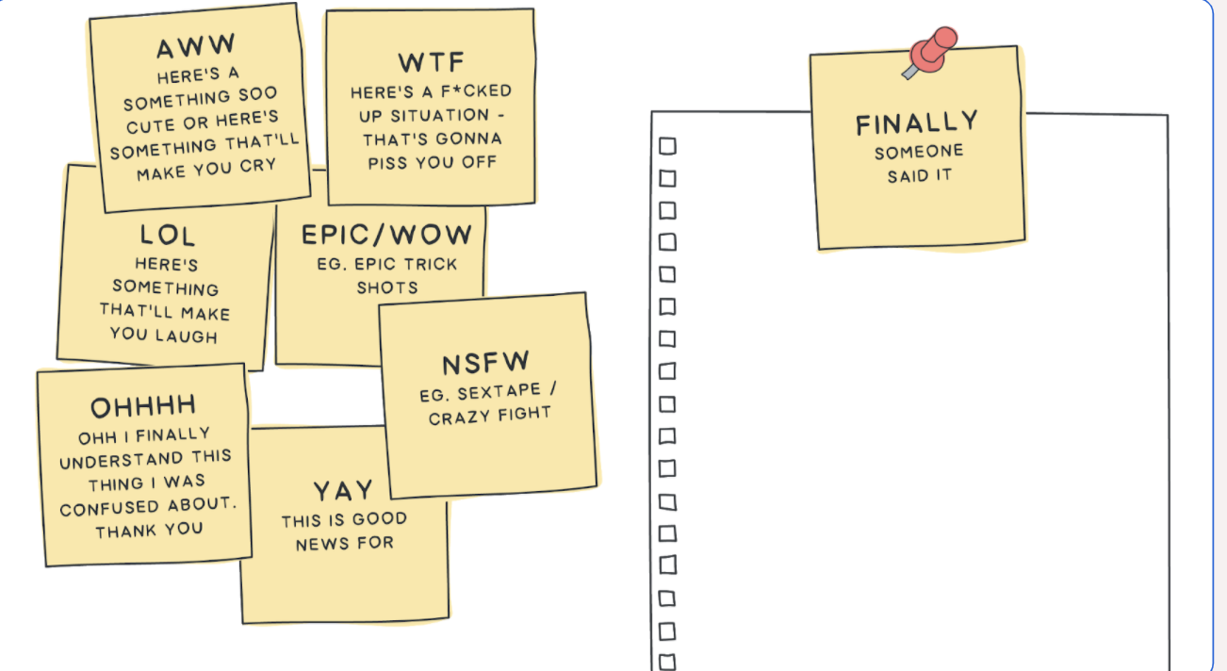
IDEAS
PACKAGING

Slide 5
80% of people don’t read past the headline
If the headline doesn’t catch them, they won’t ever see the body.
Imagine 5 people standing in front of you while you talk.
4 of the 5 people would not hear anything past the first line.
1 person would listen to all the great detail and specifics.
The headline & subject line are KEY!

Slide 6
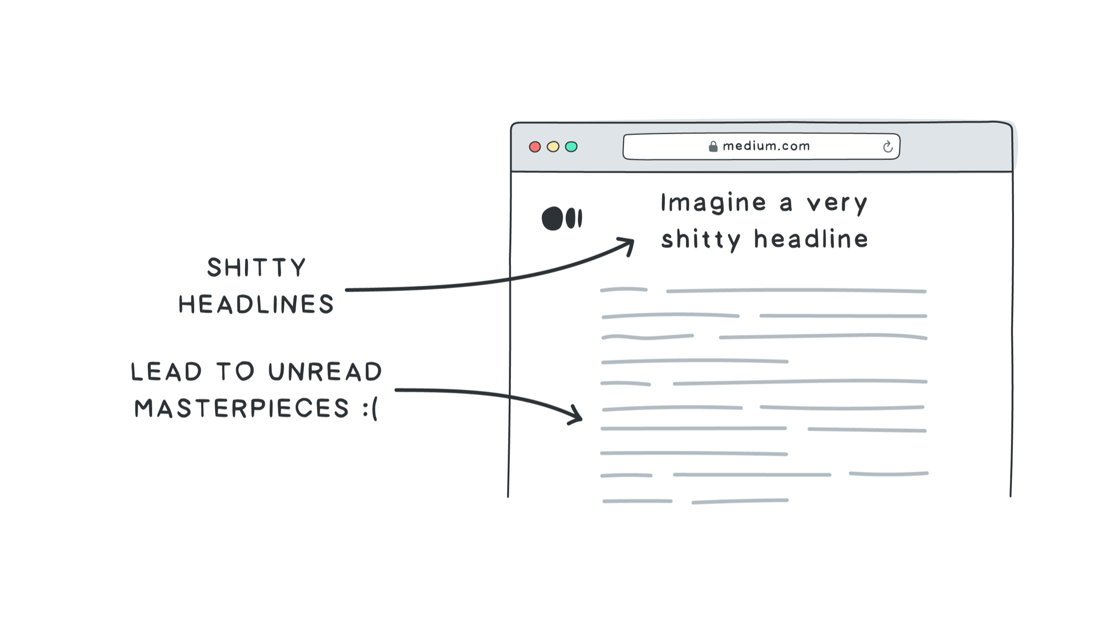

Slide 7
Btw - when I say “headline” that means anything:
The headline of a blog post
The subject line of an email or newsletter
The first tweet of a twitter thread
The caption of a linkedin Post
The caption of a facebook Ad
etc...

Slide 8
Try it:
Go find the last thing you wrote online. Maybe a blog post. Or a newsletter. Or A twitter thread. What was your headline?

Slide 9
The Goal of a Headline
Get your attention (be “scroll-stopping”)
Success == get them from line 1 ---> line 2

Slide 10
P.S. to my shy friends
I know that writing “attention grabbing” headlines or subject lines can feel “too salesy” or “over the top”
I felt that way too at first. Very common for builders to feel uneasy about it.
If that’s you - here’s some food for thought:
Think of it like a knob you can turn. Level 10 = maximum attention grabbing. Today. Learn what level 10 looks like. Then choose to turn it down once you have the ability
You are the “builder” and “seller” of your content. If you made good content, you’re doing yourself an injustice by half-assed selling it.
Nobody ever complains if your content is good. In fact, the opposite. They thank you for getting it in front of them.

Slide 11
MISTAKE
Writers spend 5% of their time on the headline, and 95% on the body
But…
Readers spend 80% of their time on the headline, and 20% on the body
This is a mismatch.
A power writer spends AT LEAST 30% of time on the headline.
So - if you’re going to spend an hour writing something, at least 20 minutes should be coming up with variations of the headline/subject line (and subheader)
This feels WEIRD. Trust me, it works.

Slide 12
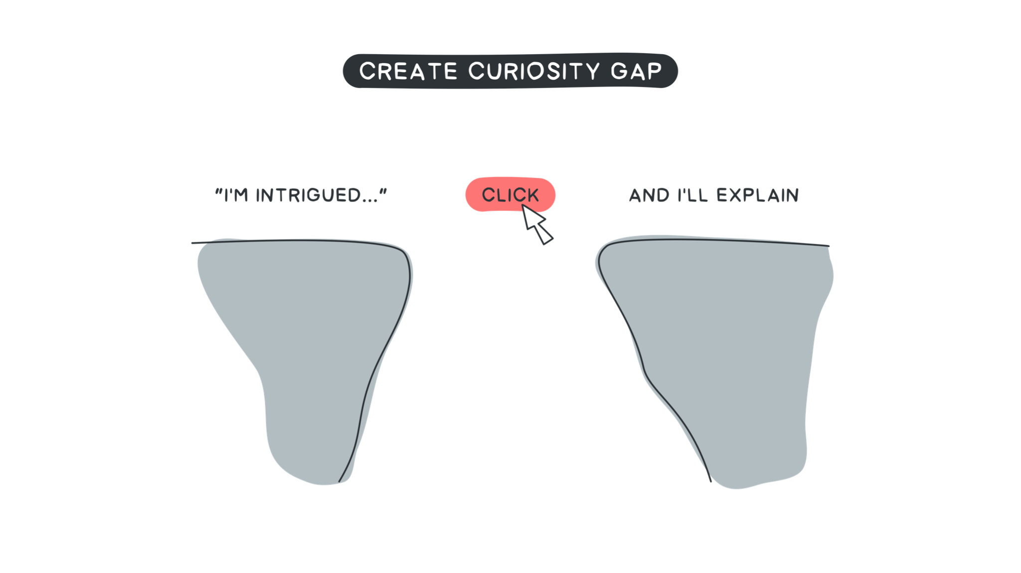

Slide 13
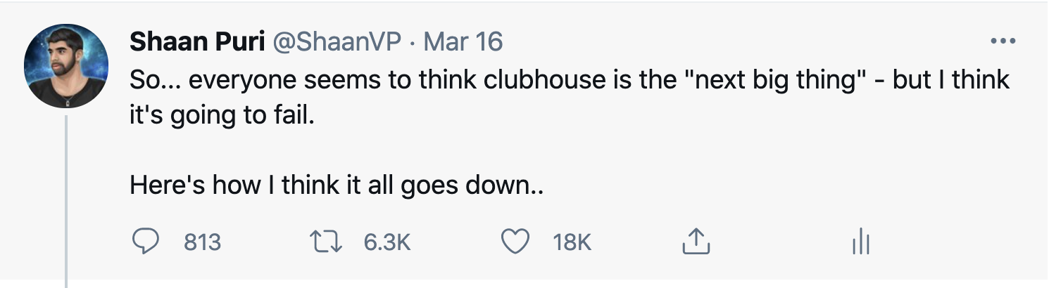
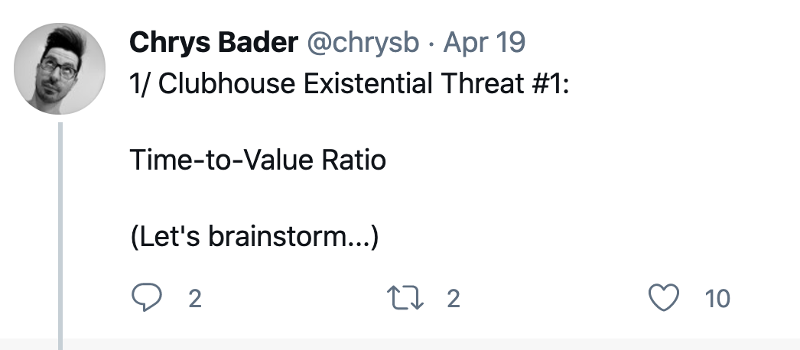
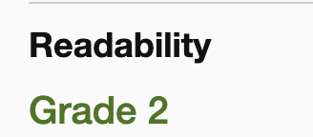
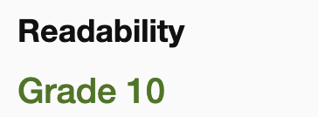
Simple words
Promises the juicy gossip (‘how it all goes down”)
Clear storyline (everyone thinks it’s the next big thing … i think it’s going to fail)
== 18,000 likes, got on CNBC
Using Jargon & fancy words (“existential threat”, “time-to-value ratio”)
Promises a brainstorm
No storyline / frame
== 10 likes

Slide 14
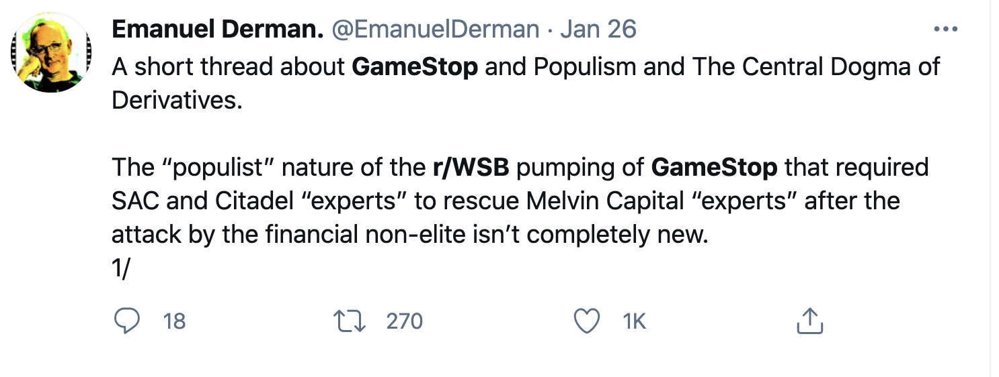
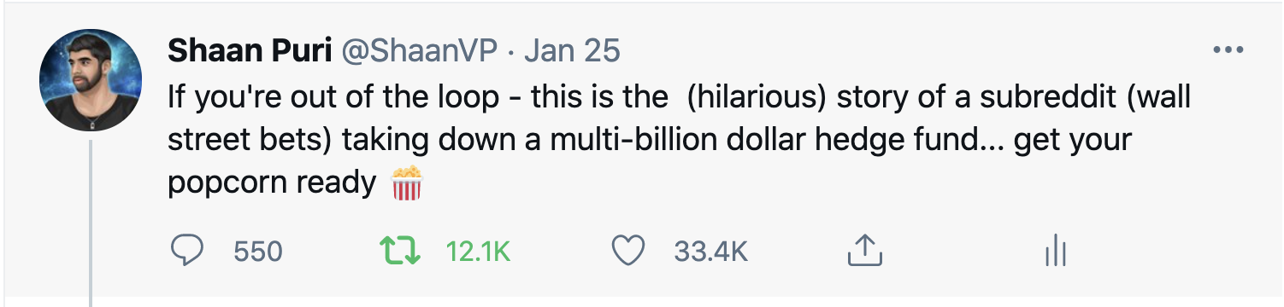
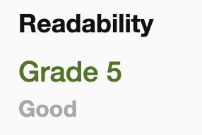
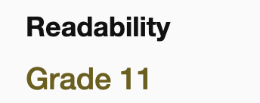
Simple words
Promise funny + entertainment 🍿
General characters (subreddit vs. hedge fund)
Clear storyline (david vs. goliath)
30x more readers
Fancy words (“populism” “central dogma” “derivatives” “financial non-elite”)
No promise of what you get by reading it
Too many names that I don’t know (SAC, Citadel, Melvin Capital)
Unclear storyline/frame. “experts?”

Slide 15
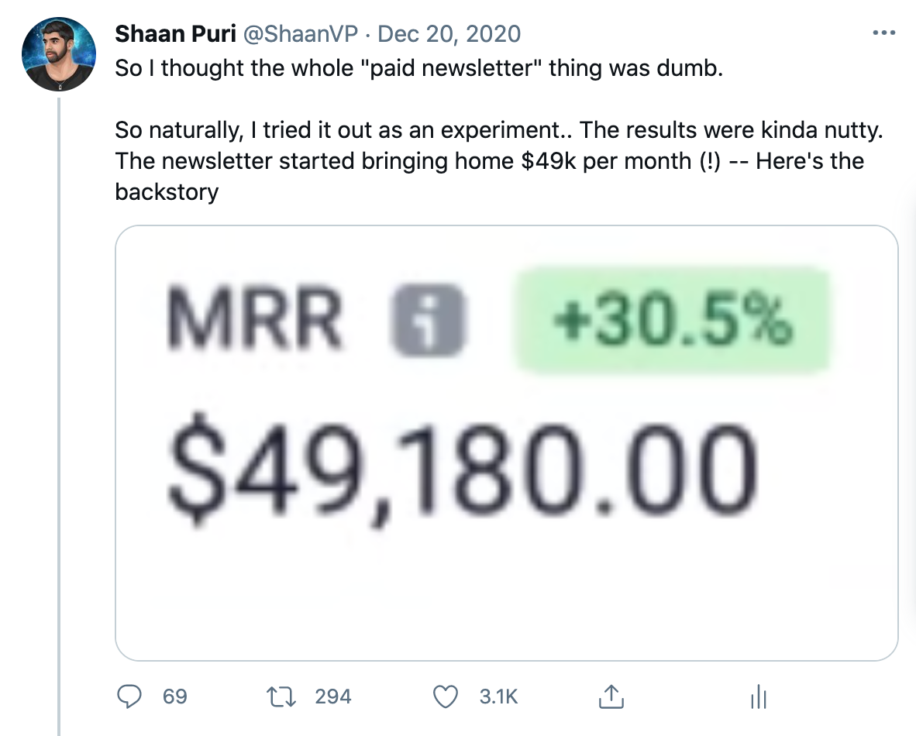
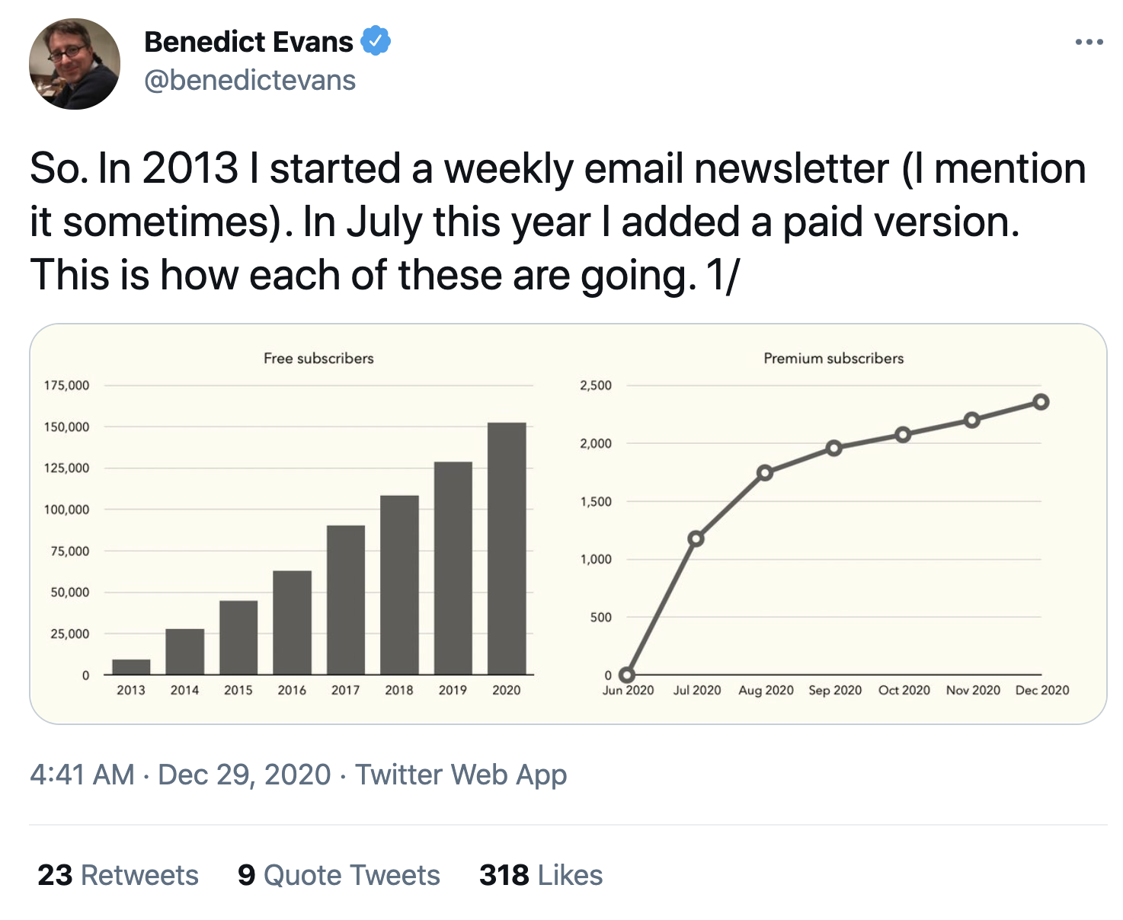
I was wrong story- I thought X was dumb. but I tried it & the results were nutty
Ho hum story. I did this. I did that. Here’s how it’s going.
Juicy Promise, here’s the backstory
No promise, just “1/”
Big bold, scroll stopping - share image
Boring sepia/yellow share image. Graph that is flatlining.

Slide 16
The curiosity gap in email subject lines
Too vague
Subject: Partnership Opportunity
Subject: 50/50 partnership Opportunity with Away Luggage
Subject: Jamie - want free luggage for life?
Too specific
Just Right.
personalized
Ok, I’m curious

Slide 17
Email example: clothing brand, selling new stuff
Boring & vague
Subject: New Styles For Summer!
Subject: New Stripes & Stars Style for 4th of July!
Subject: i need your opinion - is this the cutest 4th of july outfit or what?!
Boring & specific
32% more clicks
Not selling,
Asking for an opinion
Ok lemme click to see what it looks like

Slide 18
“Some awesome headline techniques”

Slide 19
3 surprisingly simple tips to writing clickworthy headlines
“What Buzzfeed writers know about headlines that the rest of us don’t. (grab a pencil)”
^see what I did there?

Slide 20
OK
Here are the two tools you can use everytime you write a headline.
You agree, headlines are important
You agree, even though it’s just “one line” we’re going to spend at least 30% of our time on it
You’ve seen some examples of good headlines...
51 Proven Headlines (templates)
The 25 headline exercise.

Slide 21
68 Headline Templates You Can Use (swiy.io/pwheadline)

Slide 22
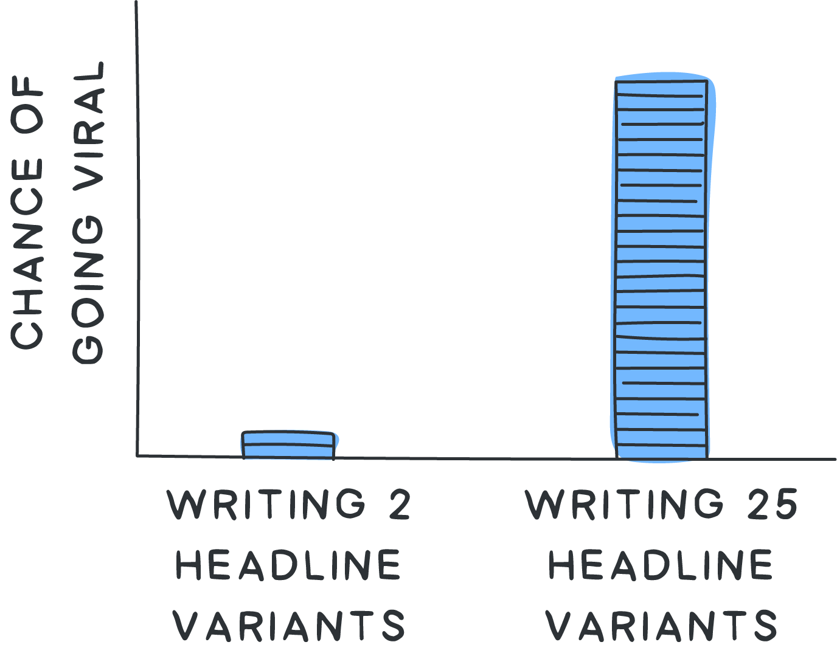
IF I want to max out clicks…
I don’t just wing it
I brainstorm 25 headlines.
Yes, 25
It only takes about 5-10 minutes. (because I use my 68 headline template)
Then I pick the best one

Slide 23
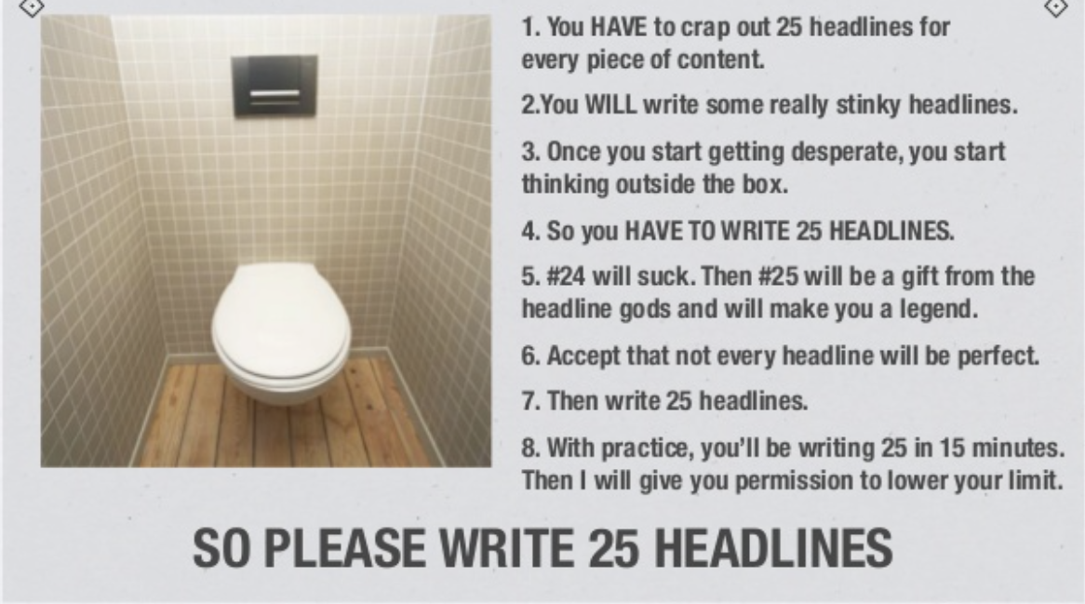
I learned this from upworthy

Slide 24
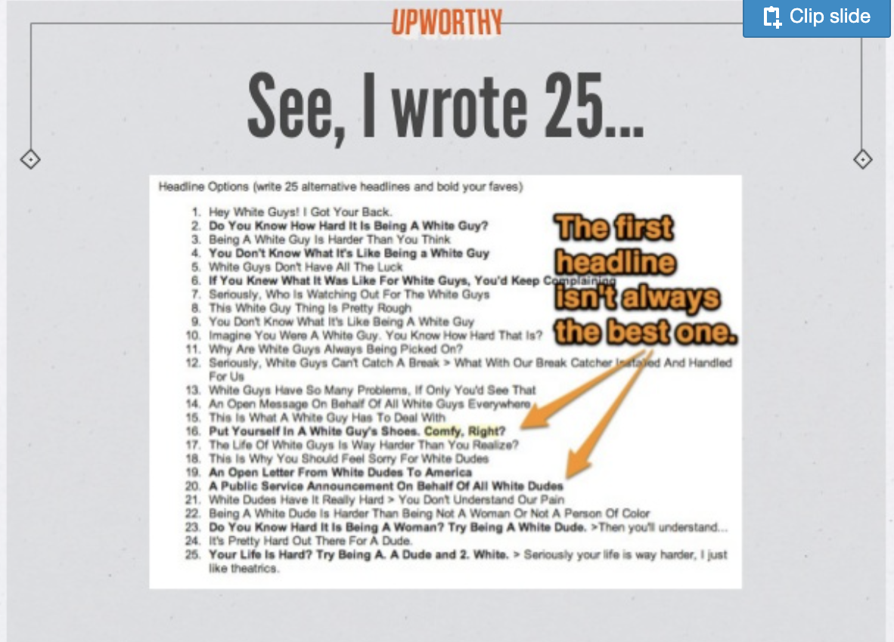

Slide 25
Your turn
Take the first headline you wrote.
Now write 25 variations. 10 mins max!
Go for QUANTITY, not quality.
Use the template I gave you for inspiration.
Put your favorite 2-3 in BOLD
POST in #Share-Your-Work in slack

Slide 26
25 headlines
Here’s what nightclubs and social networks have in common
A public service announcement to all startup founders
How tiktok is crushing youtube, with one simple advantage
The 1 piece of advice I would give myself about my last startup that failed
7 things about building a social product that people get wrong
The biggest mistake founders make when they try to create a social app
I learned this lesson the hard way. What I got wrong at my last startup
Here’s the 2 millimeter difference between succeeding and failing with a social networking startup
Dear FANG engineers. Send this thread to your PM. They need to read it.
The single mistake that sank my last startup. A brutal lesson.
The “nightclub theory” that every startup founder should know.
If you don’t know the “nightclub theory” for startup growth, you’re in trouble.
The little known secret behind the success of tiktok, twitch and instagram
This tiny little framework can save you months of pain when it comes to growth
My favorite new framework: “The NightClub Framework” for startup growth

Slide 27
takeaways
80% of people won’t make it past your headline. So spend at least 30% of your time on it!
If you want your headline to really hit, write 25 variations (yes, 25) before you push send.
Use my bank of Headlines

